Slide 1
HL7 Da Vinci Training
February ??, 2025
Coverage Requirements Discovery (CRD) Deep Dive
2025 HL7 Da Vinci Burden Reduction and Payor API Implementer Support
®Health Level Seven and HL7 are registered trademarks of Health Level Seven International, registered with the United States Patent and Trademark Office.

Slide 2

Who am I?
Name: Lloyd McKenzie
Company: Dogwood Health
Background:
One of FHIR’s 3 initial editors
Co-chair FHIR-Infrastructure, past chair FHIR Management Group, FMG member
HL7 Fellow
Technical lead for CRD IG
Da Vinci Deputy Technical Director
lloyd@dogwoodhealthconsulting.com

Slide 3
This presentation
Is part of a set of introductory training materials for the April 2025 Da Vinci Education Event
Can be downloaded here:
https://github.com/FHIR/documents/tree/master/presentations/2025-04-DaVinci
Is licensed for use under the Creative Commons, specifically:
Creative Commons Attribution 3.0 Unported License
(Do with it as you wish, so long as you give credit

Slide 4

Pre-requisites & Post-requisites
Before taking this course, you should take:
Introduction to FHIR
How to read a FHIR IG
USCDI/US Core
SMART on FHIR & CDS Hooks
Da Vinci Healthcare Record Exchange (HRex)
This course is a prerequisite to
Documentation and Templates Rules (DTR)

Slide 5

Course Objectives
After completing this course, you should be able to:
Explain the relationship between CRD and CDS Hooks
List the mandatory and optional hook types used by CRD
Describe how CRD relates to DTR and PAS
Fill out the coverage-information extension

Slide 6
Outline

Slide 7
What is CRD?
Coverage Requirements Discovery
Decision support tool for providers
What does the payer know that can help me?
Called as part of clinical workflow
Required to provide information about coverage
MAY provide other types of information

Slide 8
Primary objectives of CRD
Coverage information affects provider decisions
Is this intervention covered?
If not, intervention may not be workable for patient
Is prior authorization needed?
If so, may impact service timing, which may make a different therapy a better choice
Do I need to collect any data from the patient to support authorization/claims?
If so, better to do it now
CRD strives to have answers to these questions at the time the provider is
Writing orders, booking appointments, admitting the patient

Slide 9
A pleasant side effect
In some cases, a payer may determine:
Yes, this service is covered
The service requires prior authorization
All information needed for an authorization is available in the record
Authorization requirements are met
CRD allows an authorization number to be provided even though no authorization was formally sought

Slide 10
What CRD is not
Not a formal substitute for prior authorization
Needed data may be unavailable
CRD cannot refuse authorization
Not a tool for back-office staff
They might use CRD, but not targeted at them
Not a data collection tool
Data is held only for audit purposes

Slide 11
How CRD is different
Data coming to payer will be clinical
SNOMED, text, etc.
Actual billing codes could vary from what’s submitted
Data may be incomplete
May be missing date of service, performer/location, indication, etc.
No dollar amounts are specified
Payer response must be real-time

Slide 12
CRD Hooks

Slide 13
Supported CRD Hooks
order-select*
order-sign
order-dispatch
appointment-book
encounter-start*
encounter-discharge
Notes:
You can support others, but that’s outside CRD’s scope
Bold = must support
* = useful for caching
Not all hooks will exist
This is the typical order

Slide 14
Order Select

Slide 15
Order Sign

Slide 16
Order Dispatch

Slide 17
Appointment Book

Slide 18
Encounter Start

Slide 19
Encounter Discharge

Slide 20
CRD Response Types

Slide 22
CRD Workflow

Slide 23
Workflow overview
Enable Service
Service Discovery
Hook Prefetch
Invoke Hook
Data Retrieval
Hook Response
Act on hook information

Slide 24
Enabling a service
Clients will determine which payer services they connect to
Each payer must expose a single endpoint
One per coverage if supporting endpoint discovery, one per member otherwise
Some payers might share an endpoint
Enabling will require establishing security credentials & trust relationship
Could be site-to-site
To scale, will likely need a trust network
Client must know which payers a service supports

Slide 25
Enabling a Service (cont’d)
Registration/enabling process will include
What payers does the service support?
Needed so client knows what coverages should trigger the service
Service must be trusted to handle PHI
May require a data sharing agreement
What scopes does the CRD service want
And what is the client prepared to offer
How will identity be verified?
MTLS, FAST UDAP, FHIR Backend Services

Slide 26
CRD Endpoint Discovery
The endpoint for a CRD service can be conveyed in three ways:
Manually as part of service enablement
or via a coordinated update communicated out-of-band
Must be a single endpoint for all coverages for 1+ payers
Via a directory service
Must be a single endpoint for all coverages for 1+ payers
Automatically via HRex endpoint discovery
No more than one endpoint per coverage

Slide 27
CRD Service Discovery
A CRD server’s configuration may change from time to time
What hooks are supported?
What are the prefetch expectations for a hook?
What configuration options are available for the server?
CDS Hooks ‘Discovery’ allows retrieval of this information

Slide 28
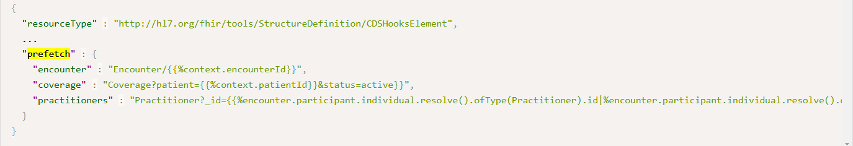
Prefetch discovery
Indicates (for a hook) what information the payer always needs
CRD Clients may or may not provide all requested prefetch information
Syntax is a list of queries to run
_include, _revinclude is not supported
Can contain simple embedded FHIRPath (x-fhir-query syntax) that refers to hook context and/or prior query results

Slide 29
What should be in prefetch?
Typically
patient, requester, location, encounter
Can include other information
Can vary by hook type
Can vary by type of request
Must
Be relevant almost always
Respect ‘minimum necessary’
Shouldn’t be the only mechanism the CRD service uses to get data

Slide 30
CRD Configuration
CRD servers may support many capabilities
Coverage information
Unsolicited prior auth
Covered therapy alternatives
Lower cost alternatives
In-network provider options
Duplicate therapy detection
Contraindication detection
Clinical guideline recommendations
Suggestions on missing tests
Some [organizations | departments | users ] may not want all of these
Some of these may also have configurable options
Degree of savings
Types of duplicate therapies to check
Etc.

Slide 31
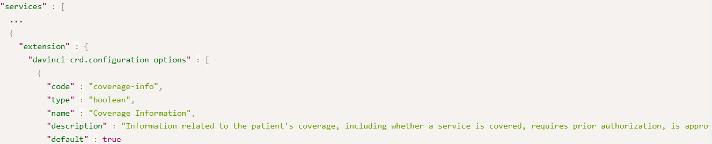
What is CRD Configuration?
List of options the CRD service supports that controls the responses it will provide + allowed values for those options
CRD clients specify the configuration options when they invoke a hook
At minimum must be able to toggle the different CRD card types and whether unsolicited prior authorization is desired

Slide 32
Example Discovery call
Request:
GET [base CRD URL]/cds-services
Response:
See here

Slide 33
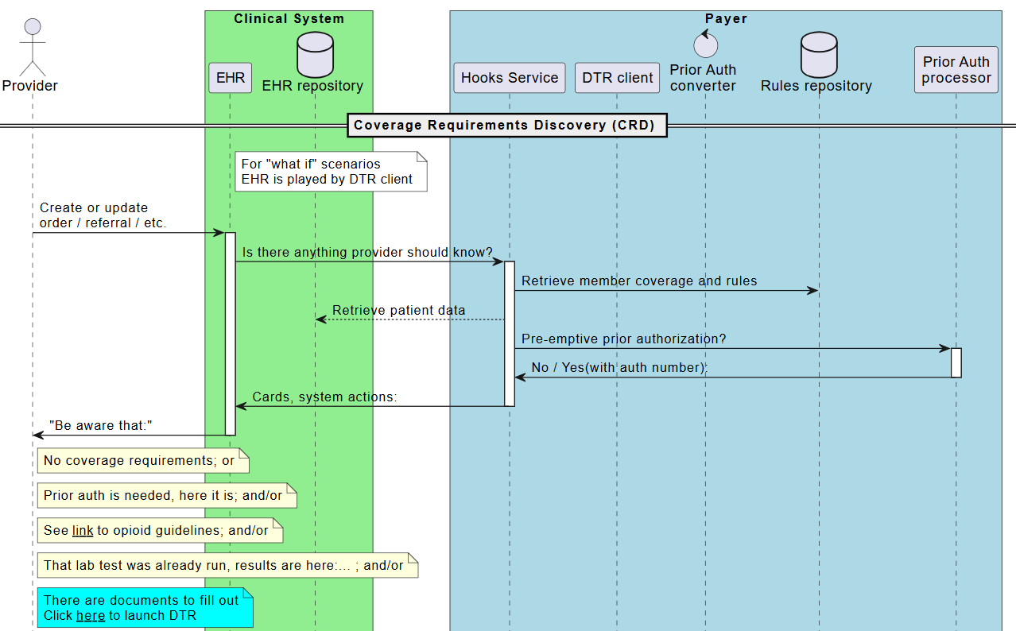
Workflow diagram

Slide 34
Hook invocation - client steps
What’s the probable primary coverage?
Which service should be called?
What prefetch data is needed?
For all orders in the hook invocation
What configuration settings apply?
for this type of order/department/user)

Slide 35
Primary coverage
CRD calls are limited to only ‘primary’ coverage
Provider won’t be choosing, so CRD client must make its best guess
If there are multiple requests
Pick the one that applies to most; or
Split requests into separate CRD calls
Once you know the coverage, you know the service
Once you know the service, you know the desired prefetch and configuration options

Slide 36
Performing prefetch
Prefetch is optional, but strongly encouraged
Clients can optimize data retrieval better than servers can
Every query + response adds delay and slows response to user
Usual query rules apply
Consent, data access permissions
A client can provide some prefetch information but not others
Empty prefetch element means “no data exists”
Missing prefetch element means “this prefetch not performed”
If a prefetch query is run, the whole thing must be run
Some prefetches can be run in parallel, others not
You don’t need to use a FHIR API to execute these

Slide 37
Configuration
Totally up to the CRD client how granular configuration should be managed
Can vary by
Department
User
Type of order
Which screen is used to order
Which hook is being used
‘Real’ vs. ‘What-if?’

Slide 38
CRD process for server
Did I get all the prefetches I asked for?
If not, query for the rest
Can I find this coverage/member?
What billing codes are possible?
What additional information should be retrieved?
For each billing code
Is it covered? More info needed? Prior auth needed? Prior auth granted?
Are there other useful things to share?
Create response

Slide 39
Querying data
May need to query CRD client because
Not all prefetches returned
Additional data is needed based on the request(s)
Check the CapabilityStatement of the server to see what query features are supported
_include, etc. may be possible
Query using batch may also be possible
Experiment whether this is more/less performant than individual parallel queries
Can query for prefetch and additional data simultaneously
Can query as requirements are identified

Slide 40
What if key information is missing?
If the base prefetch data required by CRD is
Not included as prefetch data in the hook invocation
Not available when performing a search
I.e. can’t search for it, rather than “no data exists”
Return a 412
If there’s additional data you need to
Verify coverage
Determine authorization requirements
Grant prior auth
Return coverage information as best you can. DO NOT error

Slide 41
If you can’t find the coverage
If
The member or coverage isn’t recognized
The coverage doesn’t apply to the service
The coverage is expired
Do not error
Return a coverage-information indicating “not covered” and explain why in the reason

Slide 42
What billing codes are possible?
The code used when ordering/booking an appointment/etc. will not necessarily be the code on the claim
This is true even if the ordered code is a CPT code
Payers will need to figure out what possible billing codes are ‘reasonably likely’ for a given order
If there are a small enough number, evaluate coverage requirements for all
If coverage requirements vary, return a separate coverage-information extension for each ‘set’ with different rules
If there are too many to reasonably evaluate
Return coverage-information saying “detailed-code” is needed

Slide 43
Billing code considerations
If there are multiple possible billing codes
Can’t return unsolicited prior authorization
Mapping order codes to billing codes is complex
See the presentation at the Da Vinci education event

Slide 44
Returning a response
Two types of responses:
System-action
Automatically creates or updates an existing record
Used for
If updating, use the

Slide 45
What about delegates?

Slide 46
Data retrieval
Returning cards
Returning system actions
Subsequent hooks
What-If Invocation
EHR can perform what-if locally, or launch a SMART app
Must indicate that no prior auth is wanted
CRD Hooks
CRD Responses
Coverage Information extension
CRD security expectations
Data is exchanged over TLS (as per Hrex)
CDS Clients decide whether to invoke CRD services and what the payer can see
CRD service queries need to adhere to minimum necessary
Data received is limited to providing decision support, audit, and tracking issued authorizations
Data is limited to scopes server needs and client is willing to offer
Token expiration should be 30 seconds or less
Other expectations
5 seconds (10 seconds if no prior hook for the patient in the last 24 hours)
Results longer than this may be ignored
CRD clients aren’t required to block
Results must be reliable

Slide 47
Outline
SDC on DTR Outline
SDC in DTR
Core Expectations
Supporting Elements
Special Elements
CQL in Questionnaires
Architecture Considerations

Slide 48
SDC in DTR
SDC on DTR Outline
SDC in DTR
Core Expectations
Supporting Elements
Special Elements
CQL in Questionnaires
Architecture Considerations

Slide 49
Why not just use SDC directly?
SDC defines a wide range of functionality
21 rendering extensions
38 behavior extensions
3 population mechanisms
4 extraction mechanisms
Modular forms
No existing implementations support all these capabilities
DTR doesn’t need all this functionality
MustSupport expectations differ from what DTR needs
Supporting everything would create less consistency across forms

Slide 50
How does DTR constrain SDC?
3 separate Questionnaire profiles (regular, adaptive, search)
Support 1 population mechanism (expression based)
Support 1 expression language (CQL)
No support for extraction
No support for modular forms
mustSupport expectations constrained to reflect DTR requirements
Added expectations for packaging of referenced resources
1 QuestionnaireResponse profile

Slide 51
SDC mustSupport
SDC has mustSupport, so does DTR
Ignore SDC mustSupport
mustSupport = true
Form fillers must handle properly
mustSupport = false
Form fillers shouldn’t blow up, can ignore
Not listed
Form fillers can ignore, could (but shouldn’t) blow up

Slide 52
Core Expectations
SDC on DTR Outline
SDC in DTR
Core Expectations
Supporting Elements
Special Elements
CQL in Questionnaires
Architecture Considerations

Slide 53
Core mustSupport elements
url & version
Mandatory
Indicate the meaning of the QuestionnaireResponses
url *can* be a URI (e.g. urn:uuid:[some guid])
It’s nice if URLs can be used to GET a Questionnaire
Multiple versions with same canonical SHOULD be compatible
i.e. data captured against one version should be valid against a different version

Slide 54
Core mustSupport elements (cont’d)
title
What the user will see
status
always ‘active’
effectivePeriod
If present, start date should always be in past
End date *could* be relevant, though is problematic

Slide 55
Item mustSupportElements
linkId
Meaningful is nice for maintainers
Driving off sequence is risky – breaking change if order changes
prefix
Do you have text instructions that refer to it?
readOnly
Scores?
Initial
Minimize user effort
Only if high confidence that one answer will be most typical

Slide 56
Item hierarchy
Items can nest inside items
Use groups to organize ‘related’ content
Nested questions to capture details about a specific answer
Overly complex nesting should be avoided
Harder to maintain
Potentially confusing for clinicians

Slide 57
Questions and group labels
Text of questions and labels will drive what answers you get
Balance between clarity and conciseness
Language should be targeted at intended user
Clinician vs. back-end-staff
Location in business flow may be different

Slide 58
Using ‘display’ items
Can appear anywhere
Order and nesting controls rendering
Every display item is more for a provider to read
Be judicious
Be concise
Only where really needed
Consider the ‘supportLink’ extension instead

Slide 59
Item Type Considerations
Boolean
Avoid if there’s a need for ‘unknown’ or ‘unanswered’
Integer
Don’t use for grades or enumerations, only for counting
Quantity
Use integer or decimal unless units can vary
Consider separate questions for value and unit if comparator not needed
Otherwise, need unitOption or unitValueSet

Slide 60
Item Type Considerations (cont’d)
Resource
Only if you’re confident that relevant data will be searchable
At minimum need referenceResource
SHOULD have candidateExpression
Better than referenceProfile

Slide 61
Choice vs. open-choice
Open-choice = Coding or free text
Consider nested question on ‘other’ for more control
Free text will be of limited use in automated decision-making
In either case, need answerOptions, answerValueSet or answerExpression

Slide 62
Defining Allowed Choices
answerOptions
Must be defined separately on each question
Can be codes, dates, numbers, times, etc.
Maintained as part of the Questionnaire
Can have pictures, complex XHTML, mark certain items as exclusive
Ordinals can vary for the same code
answerValueSet
Define once, use for many questions
Ensures consistency
Can only be codes
Have to maintain a separate resource
Can be contained
No support for media, option exclusive, or rendering XHTML
Ordinals must be defined by the code system

Slide 63
Defining Allowed Choices (cont’d)
answerValueSet w/ cqf-expression
Similar to answerValueSet, but can point to different valueSets based on other answers
Must still have a ‘base’ answerValueSet that contains all possible answers
answerExpression
Uses CQL to determine the list of possible valid Codings
Can theoretically be any data type
Can depend on answers elsewhere in the instance
Logic can complex

Slide 64
Contained vs. External ValueSets
External ValueSets
Share allowed answers across Questionnaires
Could change independent of the Questionnaire
Consider version-specific references
Make Questionnaire lighter
Could result in a smaller ‘package’ if many Questionnaires in the package share a ValueSet

Slide 65
Supporting Elements
SDC on DTR Outline
SDC in DTR
Core Expectations
Supporting Elements
Special Elements
CQL in Questionnaires
Architecture Considerations

Slide 66
mustSupport Behavior Elements
Core:
maxLength
required
repeats
Extensions:
mimeType
referenceProfile
referenceResource
unitOption
unitValueSet
Expectations
DTR clients must:
enforce these rules in their UIs
Use these rules to filter allowed answer options
Allow capture of data that conforms to the rules
E.g. repeating answers
Notes:
referenceResource is key for items of type Reference.

Slide 67
Optional Behavior Elements
Extensions
answerOptionsToggleExpression
constraint (also on item)
maxDecimalPlaces
maxSize
minLength
minOccurs, maxOccurs
minQuantity, maxQuantity
minValue, maxValue
optionExclusive
regex
Expectations
DTR clients can’t fail if present
DTR clients MAY enforce rules when validating forms
On entry or completion
Questionnaires SHOULD provide user instructions (via display items) that describe these rules
DTR servers should anticipate that they may receive Questionnaires that don’t follow the rules

Slide 68
mustSupport Rendering Elements
Extensions
hidden
itemControl
renderingXhtml
(only mustSupport for item.text)
supportLink
Expectations
Must be able to render as defined by the extensions
Must support all of the possible itemControl codes
Must handle rendering Xhtml content for item text
Must also check that the XHTML follows HL7 safety rules

Slide 69
Optional Rendering Elements
Extensions
choiceColumn, choiceOrientation
collapsible
displayCategory
entryFormat
itemMedia, itemAnswerMedia
openLabel
renderingStyle, renderingXhtml*
shortText
sliderStepValue
styleSensitive
usageMode
width
Expectations
DTR clients can’t blow up if these are present
DTR clients MAY adhere to some/all these rendering expectations
Questionnaires must function even if none of these are supported

Slide 70
Logic Support
Extensions
cqf-library
launchContext
variable
Expectations
DTR clients must support these
Only ‘defined’ contexts need to be supported
Regular forms:
Population & flow control
Adaptive forms:
Population only

Slide 71
Population Elements
Extensions
itemPopulationContext
initialExpression
calculatedExpression
candidateExpression
contextExpression
lookupQuestionnaire
Expectations
DTR clients must support all of these
DTR servers will determine which of these are relevant
Recommendations
Preference order: initialExpression, candidateExpression, contextExpression
calculatedExpression should be readOnly

Slide 72
Flow Control Elements
Elements
enableWhen
enableBehavior
Extensions
enableWhenExpression
cqfExpression (optional)
Expectations
Standard forms, not adaptive
‘enable’ must be supported by all DTR clients
cqfExpression is optional
text, required, repeats, readOnly, valueSet
Recommendations:
Use enableWhen rather than enableBehavior
If you need cqfExpression capabilities, use adaptiveForms

Slide 73
Special Elements
SDC on DTR Outline
SDC in DTR
Core Expectations
Supporting Elements
Special Elements
CQL in Questionnaires
Architecture Considerations

Slide 74
entryMode
DTR clients must support
Drives rendering and user-experience of the form
Sequential with no prior editing
Sequential with prior editing
Random completion
DTR clients must support all of these
Flow logic is easier with the first option, but it’s harder for users

Slide 75
performerType
DTR clients must support
Determines who must provide the answers
Will drive who us allowed to be ‘author’ of QuestionnaireResponse
It may be the same user entering the data
User must be told who must answer
System must allow capture of who’s providing answers if not user
If a Questionnaire has performerType of Patient, should also allow RelatedPerson

Slide 76
signature
mustSupport at root, optional on items
Use on items requires site-specific agreement
Even on root, site-specific agreement needed for expected signature syntax
Could be formal digital signature
Need to agree on canonicalization
Could be wet signature, initials, etc.

Slide 77
terminologyServer
DTR clients must support
Necessary if any value sets in package don’t have expansions
I.e. >~ 40 codes
Must be supported on root, optional on items
All relevant servers must be listed on root
Should be in order of preference
MAY list the server relevant to a particular value set on the item
DTR Clients MAY take advantage of that

Slide 78
unit
Optional
Intended to provide support when converting data from population sources
Because DTR Clients can’t be counted on handling this, use CQL to handle conversion

Slide 79
ordinalValue
Optional
Intended for use in calculating scores (possibly for other logic)
Can’t count on DTR clients handling this, use CQL to handle calculations

Slide 80
CQL in Questionnaires
SDC on DTR Outline
SDC in DTR
Core Expectations
Supporting Elements
Special Elements
CQL in Questionnaires
Architecture Considerations

Slide 81
CQL Location
CQL can appear in two locations
Inline in expressions
Expression language = text/cql-expression
Companion alternateExpression extension with ELM
Expression contains logic directly
Could still depend on libraries
In libraries
Expression language = text/cql-identifier
No need for companion ELM
Expression contains the name of a CQL expression in a Library

Slide 82
CQL Location Considerations
Inline benefits:
May make data-element assembly easier for maintenance
Logic for an element clearly lives with the element
Library benefits
Works better for most authoring environments
If using shared functions, all code is together

Slide 83
ELM
Necessary to execute logic
DTR Clients are not expected to be able to compile CQL
For expressions, sent using alternativeExpression extension
For Libraries, sent as an additional Library.content repetition
ELM must always be in JSON
lang
In either case, language/mime type is application/elm+json

Slide 84
Handling Dynamic CQL
CQL may depend on launch parameters
Best practice:
depend on answers to hidden questions
populate answers from launch parameters
CQL may depend on answers to other questions
Re-evaluate the CQL when the answers change
This may trigger a cascade of changes
Watch for looping

Slide 85
CQL in adaptive forms
New libraries may be added to a form when calling $next-question
Old libraries will remain
DTR Clients should retain variable values and past search responses
Will still need to perform queries or evaluations for newly retrieved libraries
And evaluations needed for new questions

Slide 86
Library organization
Libraries can vary significantly in size
Objectives:
Allow re-use of common components
Don’t require sharing libraries that are too large
Make maintenance straight-forward
Notes:
Key message: Think about your strategy for organizing your content

Slide 87
Architecture Considerations
SDC on DTR Outline
SDC in DTR
Core Expectations
Supporting Elements
Special Elements
CQL in Questionnaires
Architecture Considerations

Slide 88
Questionnaire Size
Small numbers of big questionnaire, lots of optionality
Lots of smaller questionnaires
On-the-fly generation of custom forms based on what’s known/what’s not

Slide 89
Adaptive Forms
Use adaptive if:
Might return coverage-information
including prior authorization numbers
Don’t like writing CQL
Still needed for population
Existing back-end can drive question logic
Logic not all driven form Questionnaire answers
I.e., need to interact with payer back-end systems during questionnaire evaluation
Too many questions for a single questionnaire

Slide 90
Adaptive forms (cont’d)
Use standard forms if:
Lots of existing paper forms
Logic is simple (and answer-driven)
Don’t want to build an adaptive service
Minimize interactions
Performance/load concerns

Slide 91
Adaptive Questionnaire Packages
Adaptive Questionnaires will use Libraries & ValueSets too
Can be sent to client in two ways:
As part of the Questionnaire Package
Always sent
For common/likely-to-be-used resources
As contained resources
When items that require them are added to the contained Questionnaire by $next-question

Slide 92
Maintenance Strategies
Modular forms
DTR doesn’t support modular forms – but it doesn’t need to
Derived forms
For CQL logic
Versioning will be important
Change version if validity expectations change or meaning changes
Or maybe change always…
Keep older versions available
QuestionnaireResponses may point to older versions

Slide 93
Resourcing DTR forms
Existing form system?
Write code to convert forms & supplement with CQL
Manually re-develop the forms from scratch
Partial conversion/manual supplementation
Otherwise, pick a form authoring tool

Slide 94
Who’s involved?
Those who write the questions
Business expertise
Knowledge of clinical practice and language
Knowledge of good form design
Those who write the logic
CQL understanding
Those who define the population rules
CQL understanding
US Core knowledge

Slide 95
Summing Up

Slide 96
Course Objectives
After completing this course, you should be able to:
List the sections from SDC used by DTR
Describe the trade-offs between adaptive and standard forms
Explain some of the considerations for using CQL with DTR forms
Design questionnaires that account for the must support and optional elements in the SDC Questionnaire profiles
Summarize the key rendering and behavioral options available for use for DTR

Slide 97



Questions/Discussion
lloyd@dogwoodhealthconsulting.com
Or, better yet, include the community and ask/discuss on https://chat.fhir.org/#narrow/channel/197320-Da-Vinci-DTR or
https://chat.fhir.org/#narrow/channel/179255-questionnaire

